Slide 1
Group Salmon: Rep Token
Kevin Hertwig, Mike Herman, Wilke Klausing | Blockchain Technologies SS21 | Final Project Demo

Slide 2
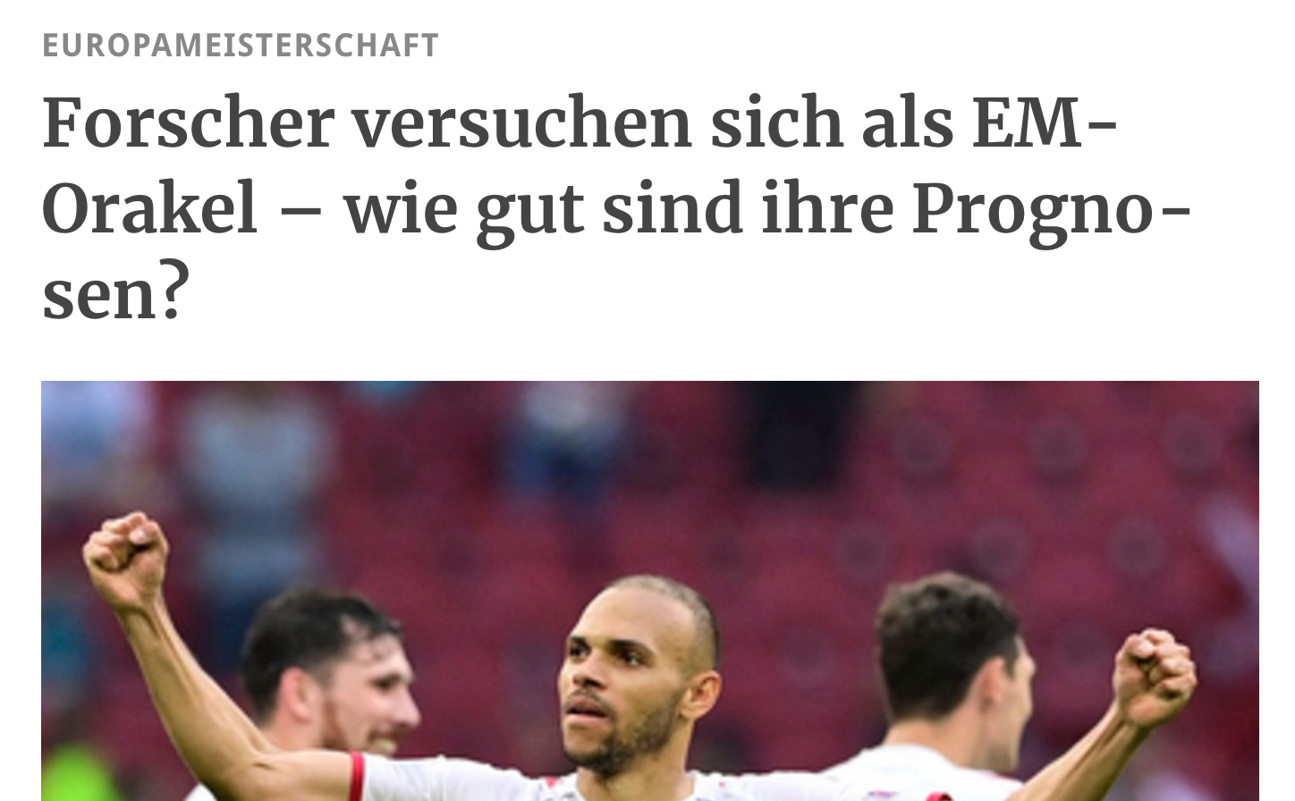
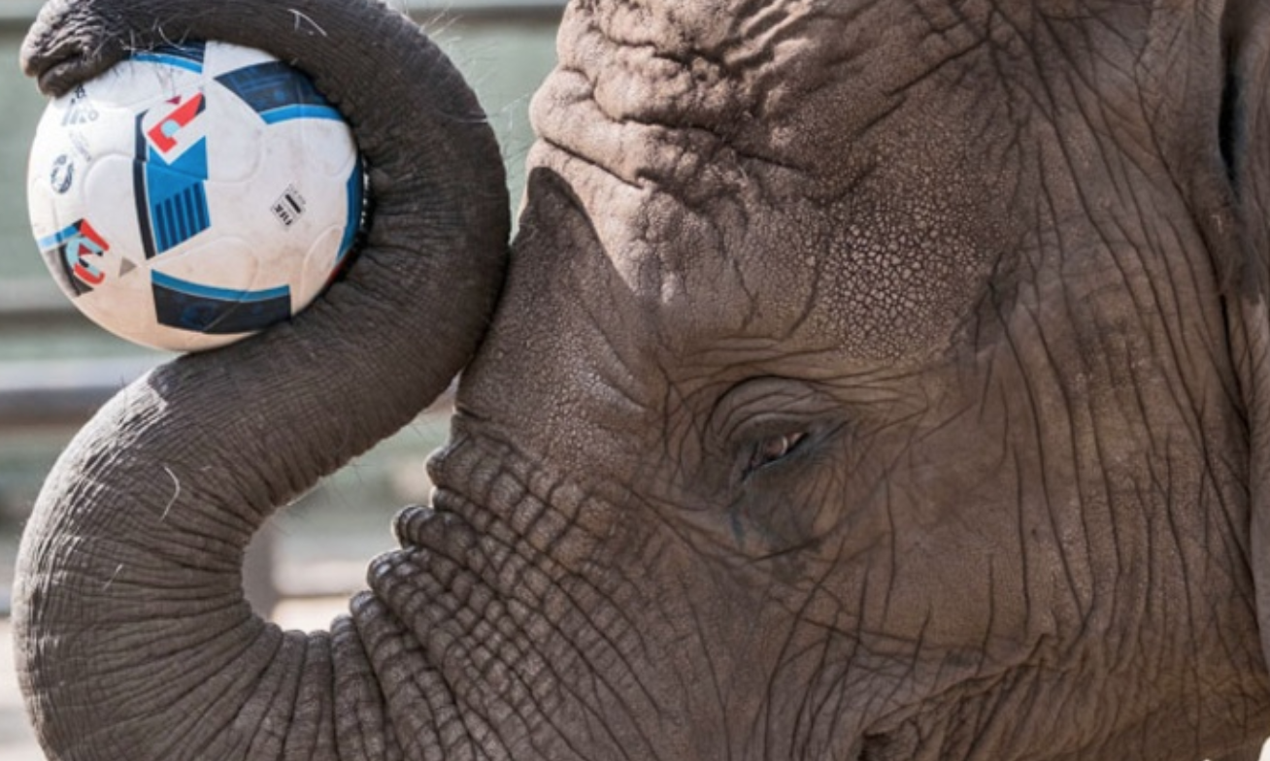
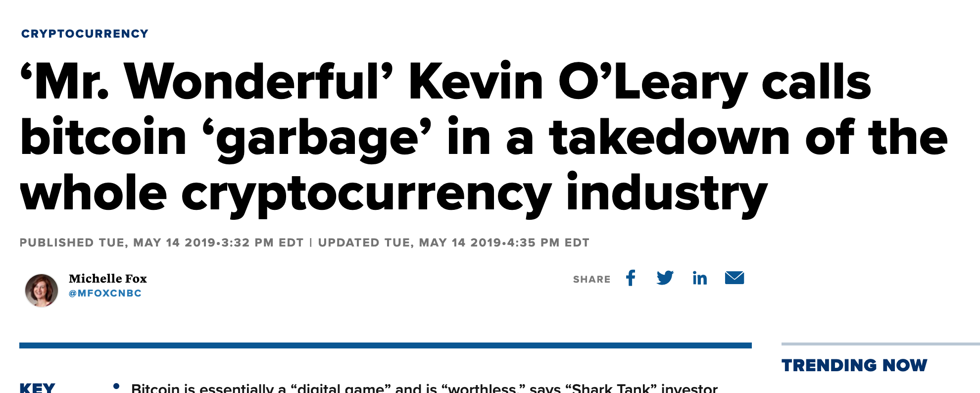
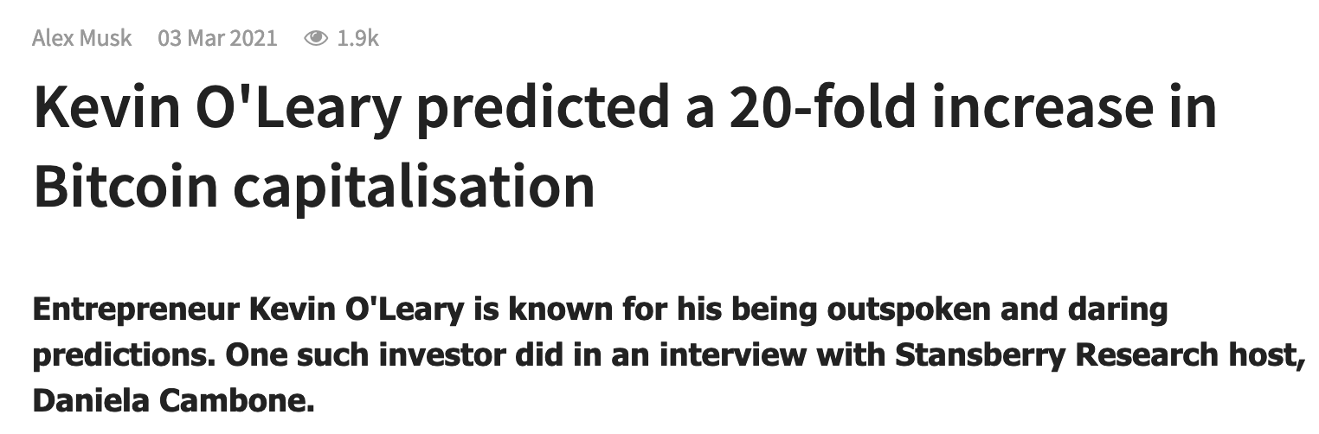
Problem statement
Self-proclaimed experts make predictions
People don’t know who to trust

Slide 3
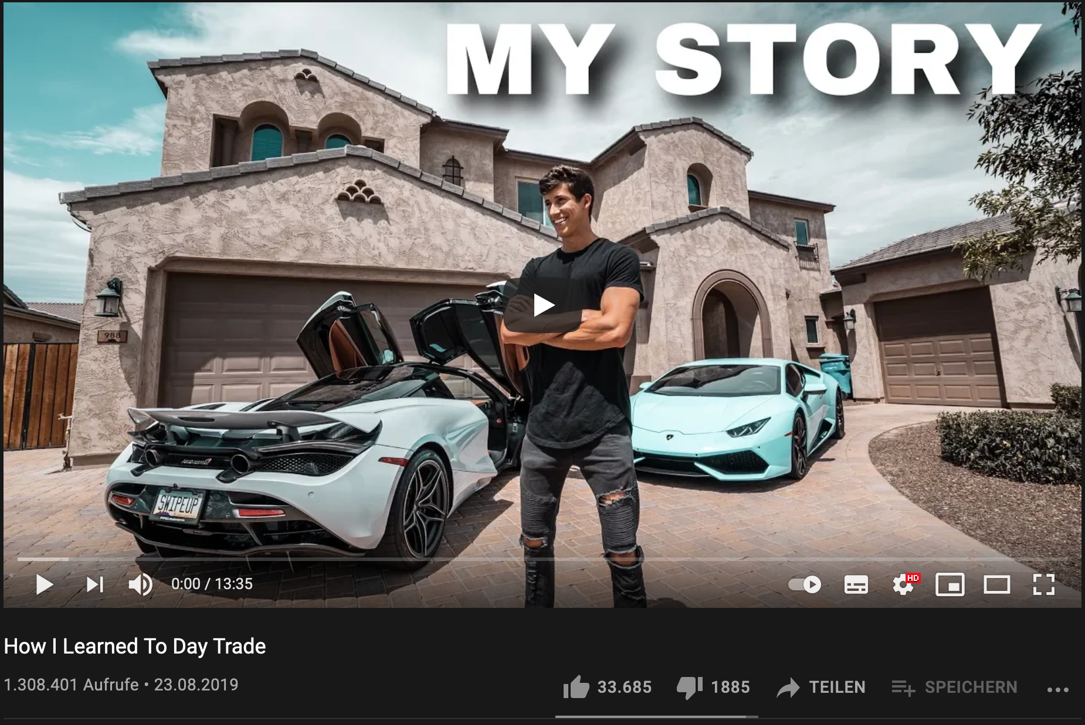
Solution: Rep Token
Indicator for how accurate stock predictions had been
Uses the transparency of the blockchain
Wrong predictions can not be removed
Predictions can only be made before the event takes place
Give silent experts a strong argument against fake gurus

